Slide 1
A Recommender System for WHOLESALER
Applied Data Science Capstone
IBM Data Science Professional Certificate
August 2019

Slide 2
Synopsis
Part 1: Problem Description
There is a wholesaler in one of the boroughs of Toronto (North York). This wholesaler supplies to places such as: Different types of Restaurants, Bakery, Breakfast Spot, Brewery and Café with fresh and high-quality groceries. The wholesaler wants to build a warehouse for the groceries it buys from villagers and farmers inside the borough, so that they will support more customers and also bring better "Quality of Service" to the old customers.

Slide 3
Synopsis
Part 2: Data
We will need geo-locational information about that specific borough and the neighborhoods in that borough. We specifically need the latitude and longitude numbers of that borough. We assume that it is "North York" in Toronto. This is easily provided for us by the wholesaler, because the wholesaler has already decided about the borough. The Postal Codes that fall into that borough (North York) would also be sufficient fo us. In fact we will first find neighborhoods inside North York by their corresponding Postal Codes.

Slide 4
Synopsis
Part 2: Data
We will need data about different venues in different neighborhoods of that specific borough. In order to gain that information we will use "Foursquare" locational information. By locational information for each venue we mean basic and advanced information about that venue. For example there is a venue in one of the neighborhoods. As basic information, we can obtain its precise latitude and longitude and also its distance from the center of the neighborhood. But we are looking for advanced information such as the category of that venue and whether this venue is a popular one in its category or maybe the average price of the services of this venue. A typical request from Foursquare will provide us with the following information:
[Postal Code] [Neighborhood(s)] [Neighborhood Latitude] [Neighborhood Longitude] [Venue] [Venue Summary] [Venue Category] [Distance (meter)]

Slide 5
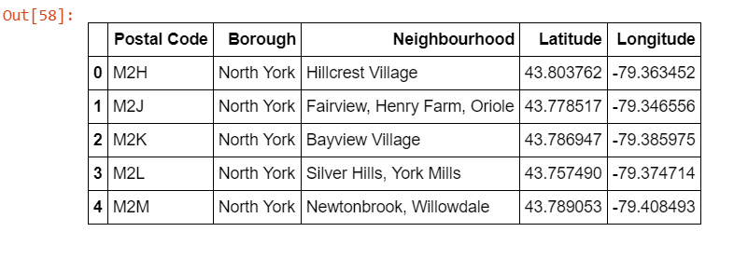
Analysis
Part 1: Identifying Postal Codes (and then Neighborhoods) in “North York"

Slide 6
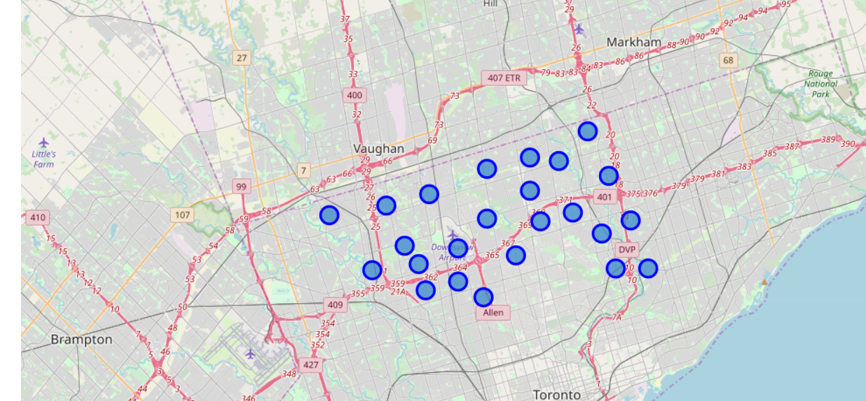
Analysis
Part 1: Identifying Postal Codes (and then Neighborhoods) in “North York"

Slide 7
Analysis
Part 2: Connecting to Foursquare and Retrieving Locational Data for Each Venue in Every Neighborhood
After finding the list of neighborhoods, we then connect to the Foursquare API to gather information about venues inside each and every neighborhood. For each neighborhood, we have chosen the radius to be 1000 meter. It means that we have asked Foursquare to find venues that are at most 1000 meter far from the center of the neighborhood.

Slide 8
Analysis
Part 3: Processing the Retrieved Data and Creating a DataFrome for All the Venues inside the North York
When the data is completely gathered, we will perform processing on that raw data to find our desirable features for each venue. Our main feature is the category of that venue. After this stage, the column "Venue's Category" wil be One-hot encoded and different venues will have different feature-columns. After On-hot encoding we will integrate all restaurant columns to one column "Total Restaurants" and all food joint columns to "Total Joints" column.

Slide 9
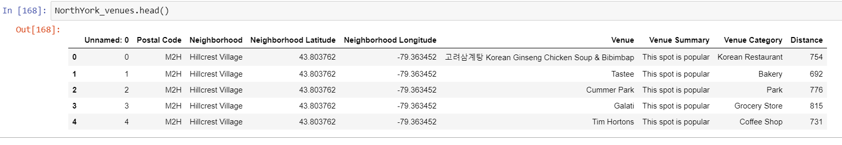
Analysis
Part 3: Processing the Retrieved Data and Creating a DataFrome for All the Venues inside the North York

Slide 10
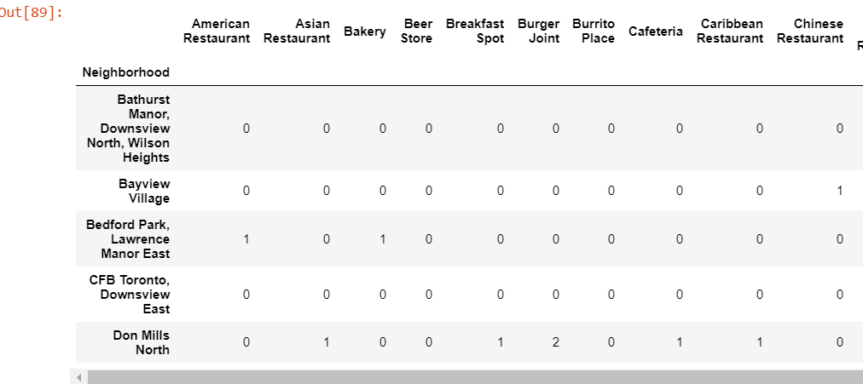
Now, the dataset is fully ready to be used for machine learning (and statistical analysis) purposes.

Slide 11
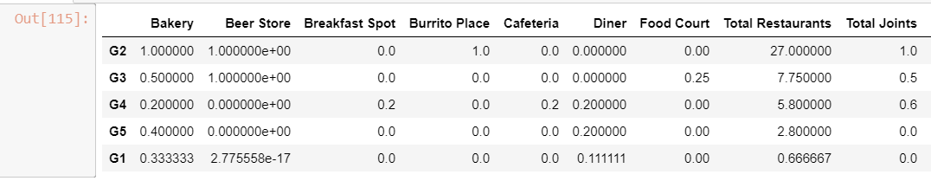
Part 4: Applying one of Machine Learning Techniques (K-Means Clustering)

Slide 12
Decision Making and Reporting Results
Now, we focus on the centers of clusters and compare them for their "Total Restaurants" and their "Total Joints". The group which its center has the highest "Total Sum" will be our best recommendation to the contractor. {Note: Total Sum = Total Restaurants + Total Joints.} This algorithm although is pretty straightforward yet is strongly powerful.

Slide 13
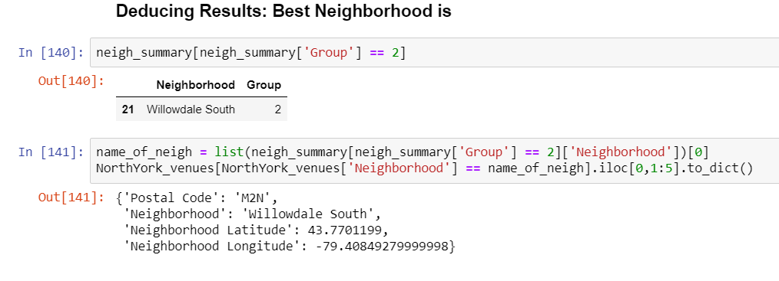
Decision Making and Reporting Results

Slide 14
THANK YOU

